Slide 1

Authors:
Diego Ávila, 903988
Laura Schiatti, 904738
Sukhpreet Virdi, 904204
TrackMe
Project presentation
Software Engineering II Project (A.Y. 2018/2019) – Politecnico di Milano

Slide 2
Context

Slide 3
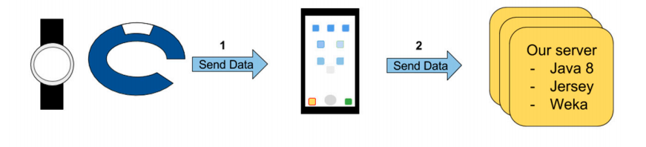
Problem and Scope
Data4Help
AutomatedSOS
Track4Run
TrackMe develops health-monitoring devices devoted to measure and record different parameters related to the health status of a person and location.
To improve customers’ experience, TrackMe decided to
offer three new services
Our Server

Slide 4
World and shared phenomena
S h a r e d
Emergency contacts
Running path
Individuals
Wearable devices
Third-parties
Collected data
(health status and location)
Individuals’ current location
W o r l d

Slide 5
Goals <<Data4help>>
The individual can allow (or refuse) Data4Help to use their data
G1
The third party company should be able to access data of a
specific individual
G2
The third-party company should be able to access anonymized
data of groups of individuals under certain constraints
G3
The third-party company could subscribe to get new data related
to specific individuals or previously saved search
G4

Slide 6
Goals <<AutomatedSOS - Track4Run>>
Provide a service capable to send a notification to the health-care
service when any individual’s parameter is out of range
G5
Run organizers could define the path for a given run and TrackMe
users can enroll to it
G6
Run spectators could track the position of all the runners during a
race
G7

Slide 7
User characteristics
Individuals
Third-party companies
Users
Organizers
Spectators

Slide 8
TrackMe model

Slide 9
Domain assumptions
Wearables accuracy when monitoring individuals
[D1]
TrackMe addresses data protection and integrity against possible attacks.
[D2]
The organizers hold all needed permissions to set up a run
[D7]
TrackMe devices are up and running during monitoring.
[D3]
Out of coverage scenarios cannot be handled by ASOS
[D6]
The data collected schema is directly related to the individuals' by their SSN and has the proper structure.
[D4]
SSN provided by the individual is valid and trustable
[D5]

Slide 10
Use case diagram
<<Data4Help>>

Slide 11
Use case diagram
<<AutomatedSOS>>
Use case diagram
<<Track4Run>>

Slide 12
Architectural design

Slide 13
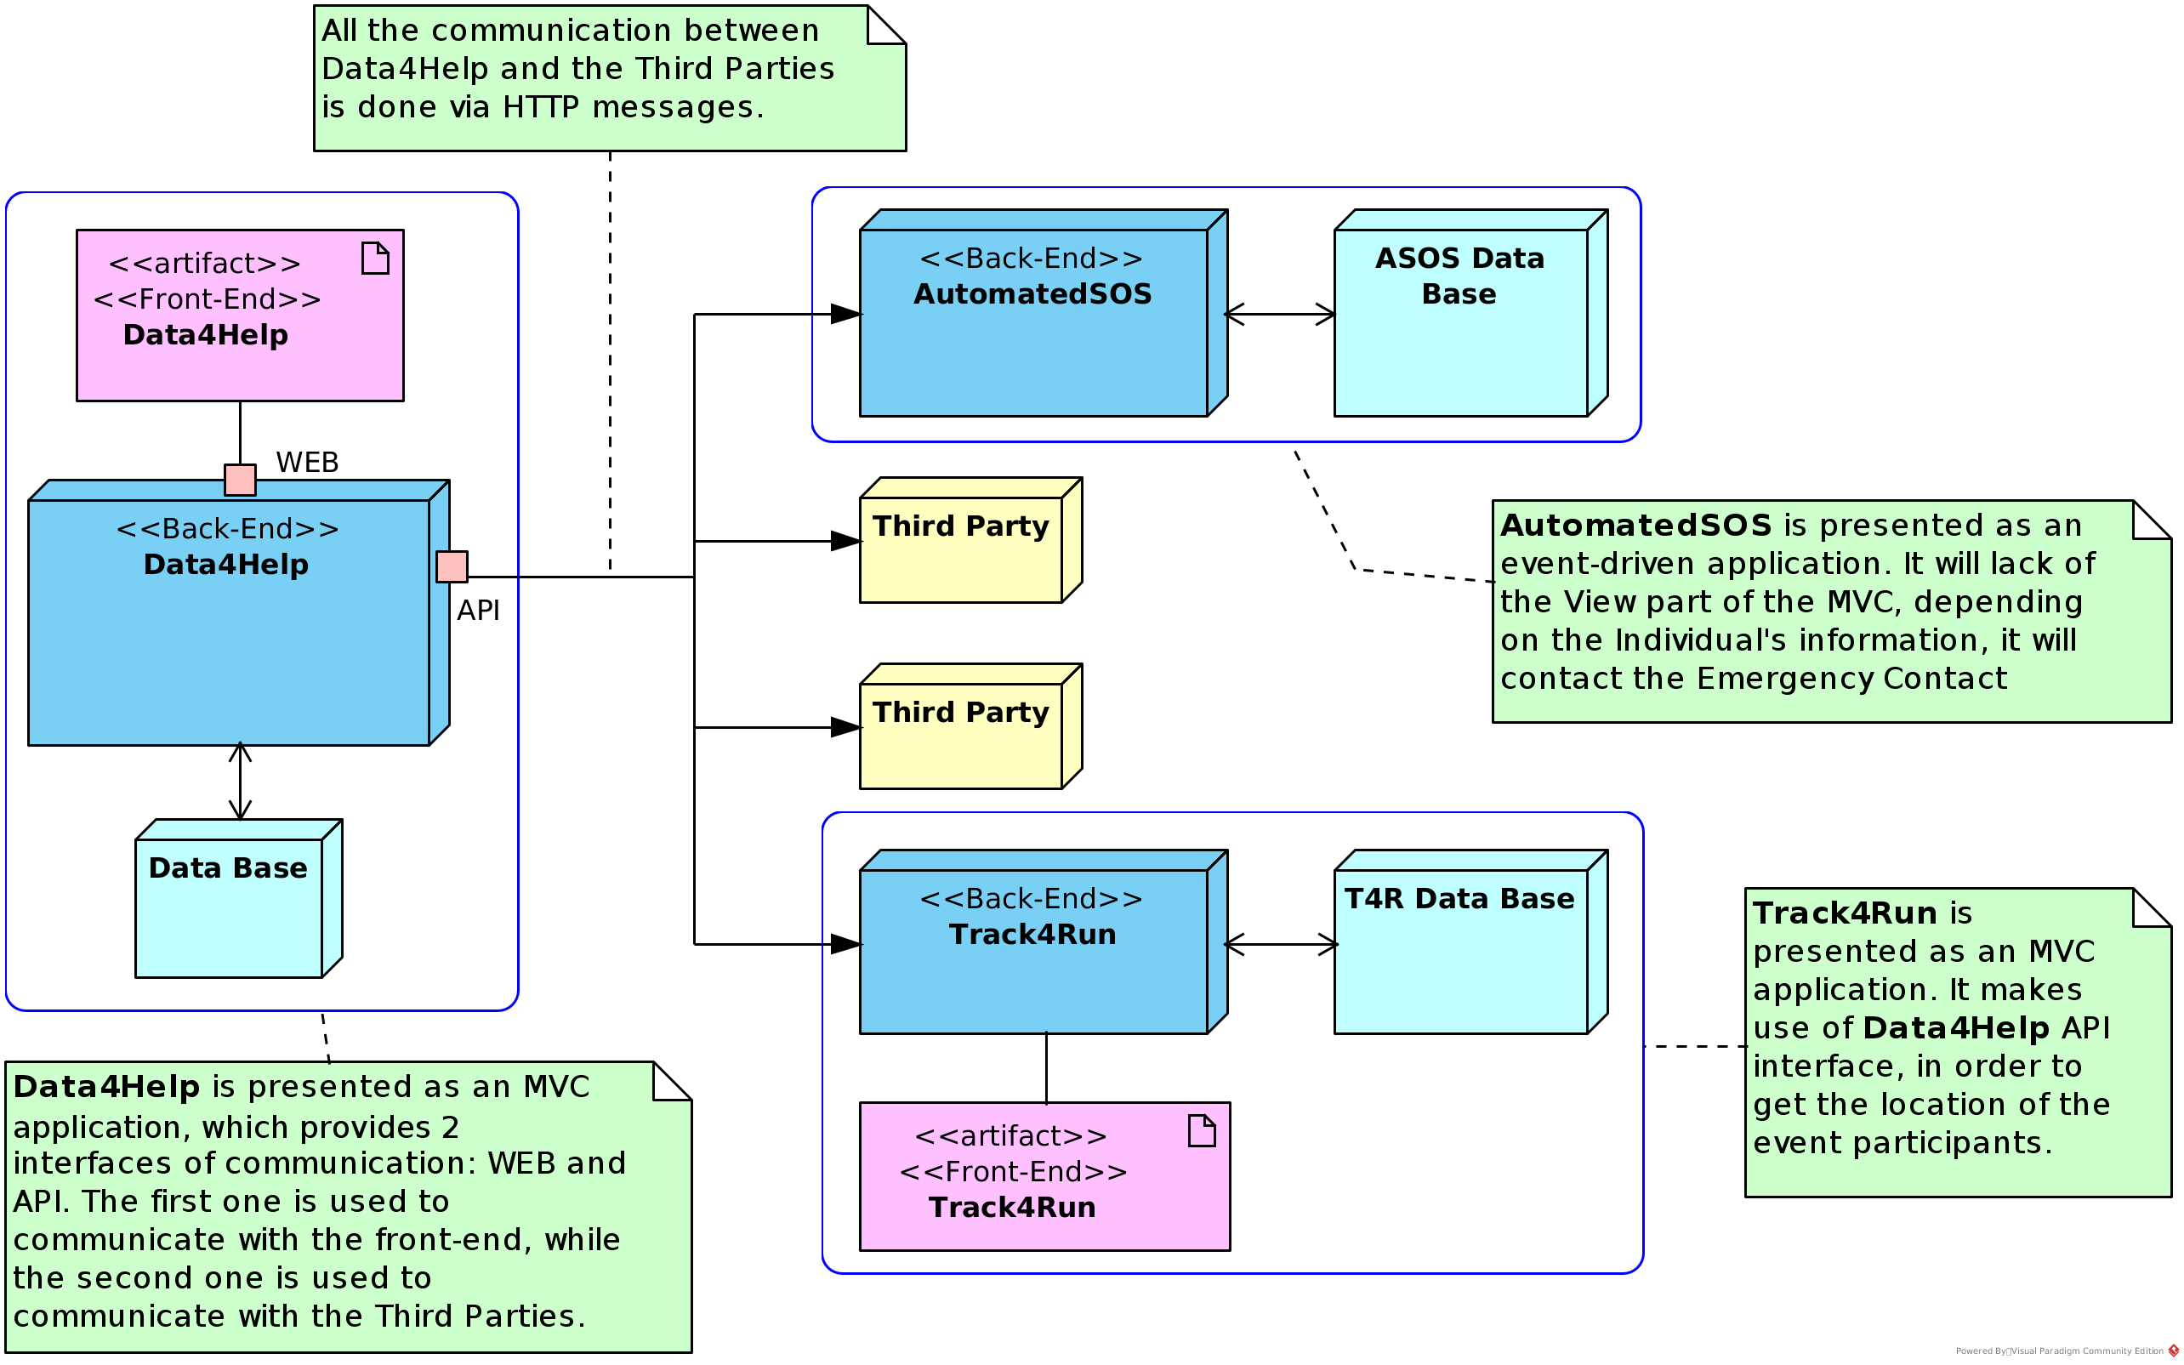
Overview

Slide 14
Overview
Data4Help and Track4Run
MVC architecture << web interface >>
AutomatedSOS
Event-driven architecture << no interface for users >>
Third parties
communicate with Data4Help using HTTP messages

Slide 15
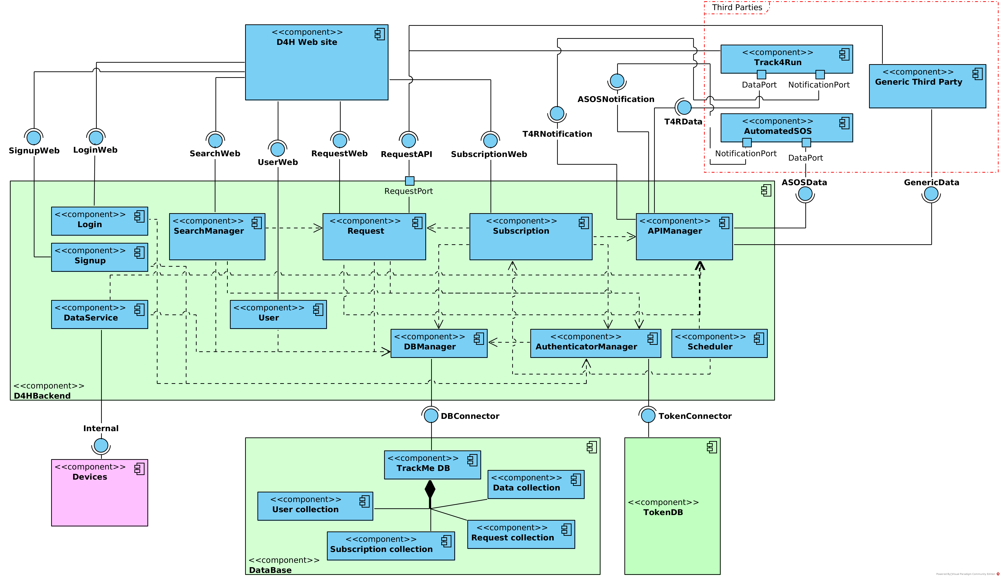
Components <<Data4Help>>

Slide 16
Components - Data4Help
DataBase and D4HBackend: first one refers to the D4H database, which provides an interface used by the DBManager component; contains all the components related to D4H, which are needed to provide the interfaces used by the third parties and the web site.
Signup, Login, SearchManager, Request, User and Subscription, components provide interfaces used by the web site.
Request component provides an interface used by the third parties.
DataService component has the responsibility of get the data from the TrackMe smart devices, and store it in the data base.
Devices component makes reference to the smart-watches sold by TrackMe
Track4Run and AutomatedSOS are like third parties.

Slide 17
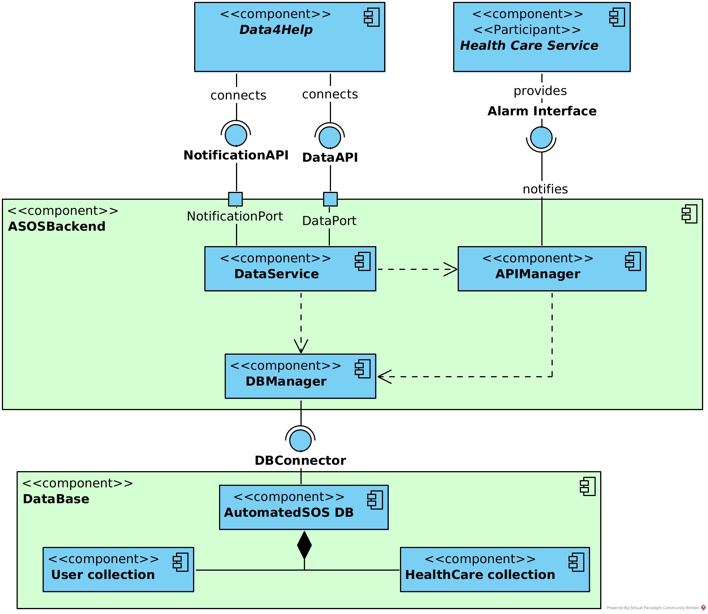
Components
<<AutomatedSOS>>

Slide 18
Components - AutomatedSOS
As in D4H and T4R, the main components are ASOSBackend and DataBase​.
DataService, is responsible of getting the data of the individuals and the notifications of accepted or rejected requests​.
APIManager is responsible of sending the notifications to the Health Care Service.

Slide 19
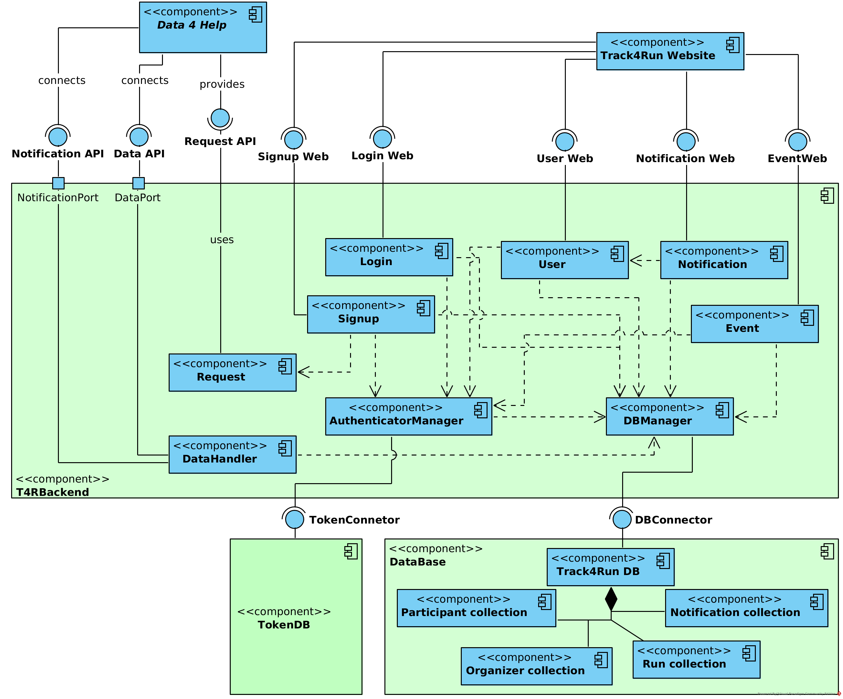
Components
<<Track4Run>>

Slide 20
Components - Track4Run
As in D4H, the main components are T4RBackend and DataBase.
Signup, Login, User, Notification, Event components provide interfaces to the web site.
Request component in this case, uses the interface provided by D4H in order to send requests to the Individuals.
DataHandler, is responsible of getting the data of the individuals and the notifications of accepted or rejected requests.

Slide 21
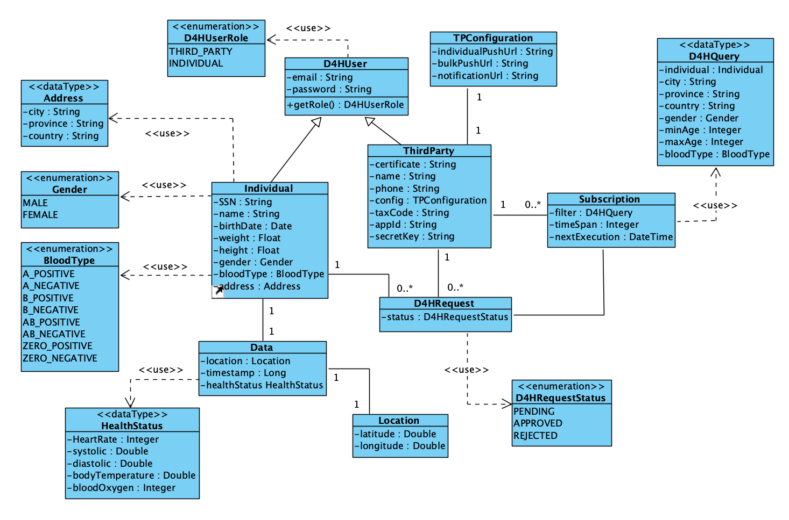
Data model
<<Data4Help>>

Slide 22
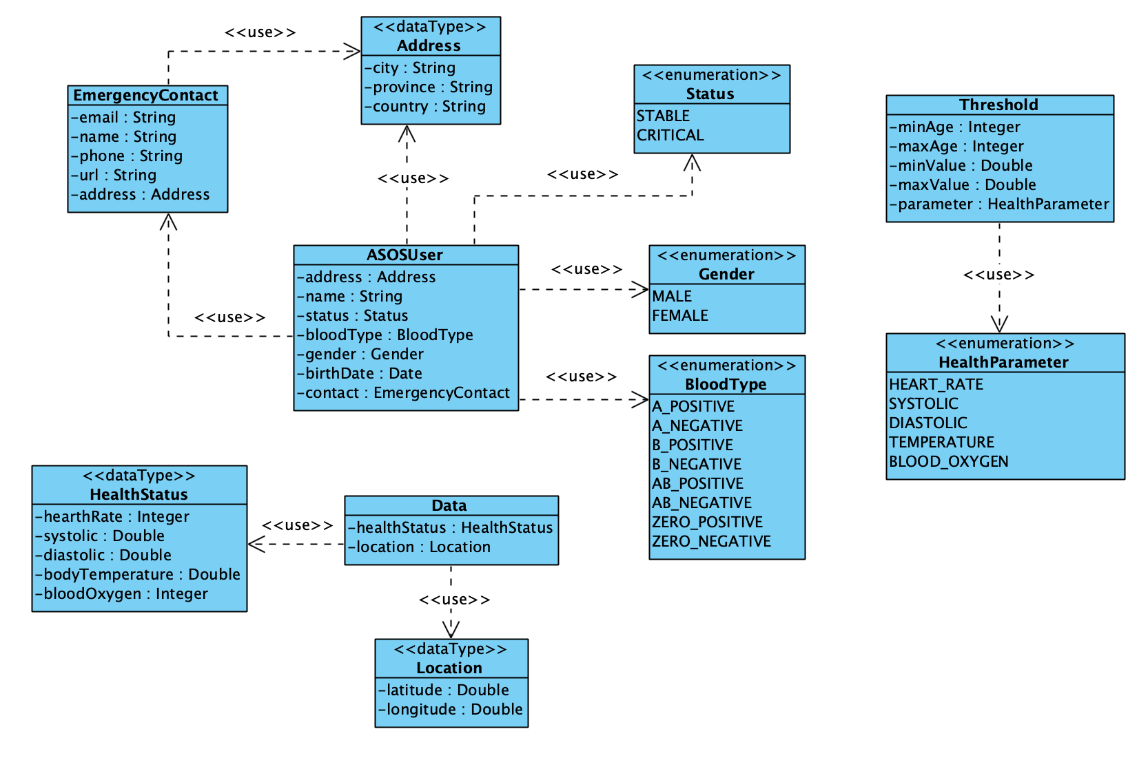
Data model
<<AutomatedSOS>>

Slide 23
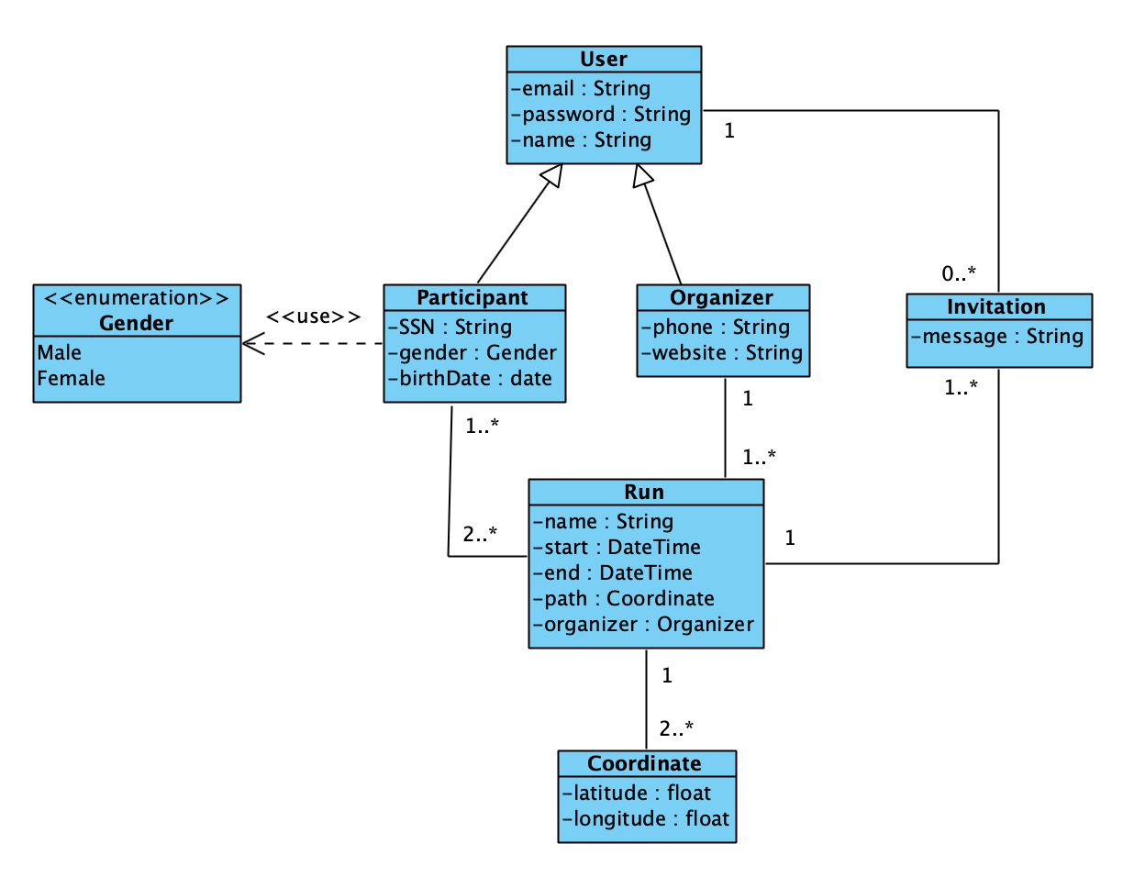
Data model
<<Track4Run>>

Slide 24
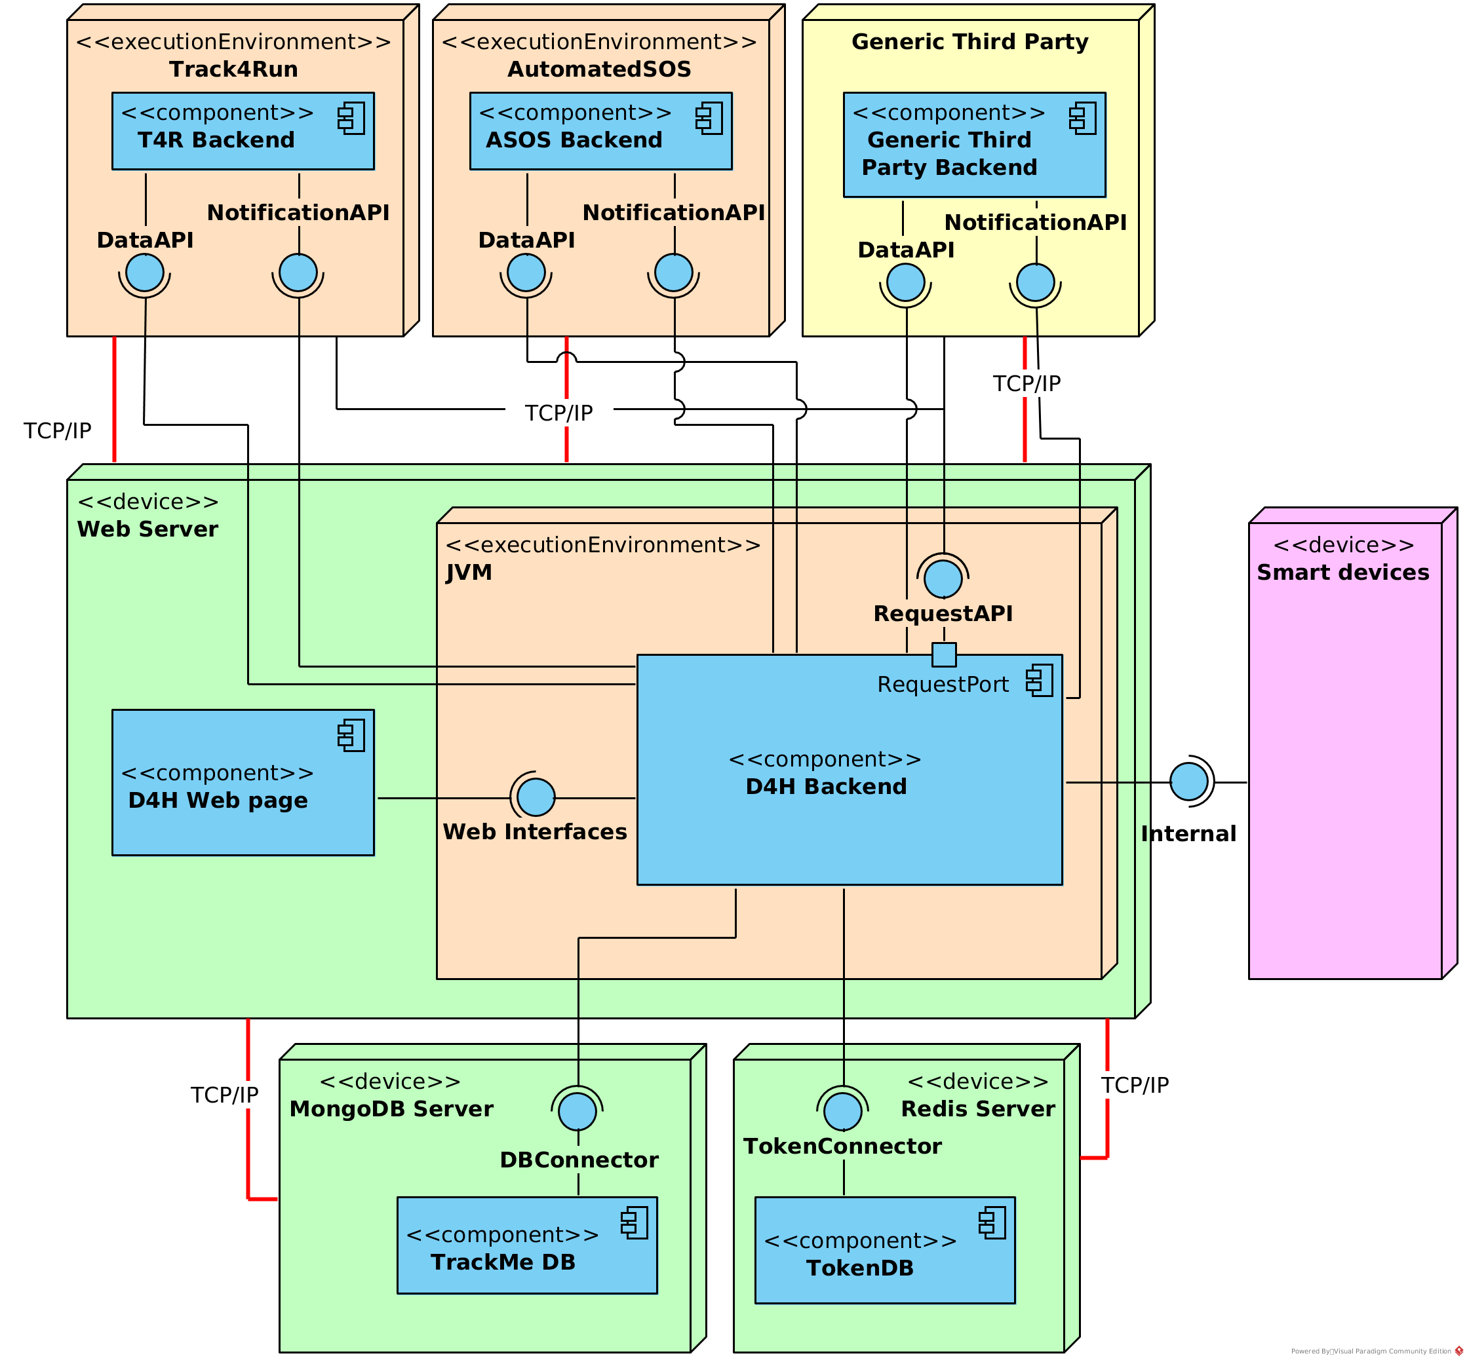
Deployment
<<Data4Help>>
Web Server node contains the web site and the backend (which runs in a Java environment)
Web Server communicates with the Smart Devices (through the Internal interface), with both Data Bases (through the TokenConnector and DBConnector) and with the Third Parties.
The individuals and third parties can interact with the system through the web site.
Here can be seen, again, that T4R and ASOS are treated as Third Parties.
Use case diagram
<<Track4Run>>

Slide 25
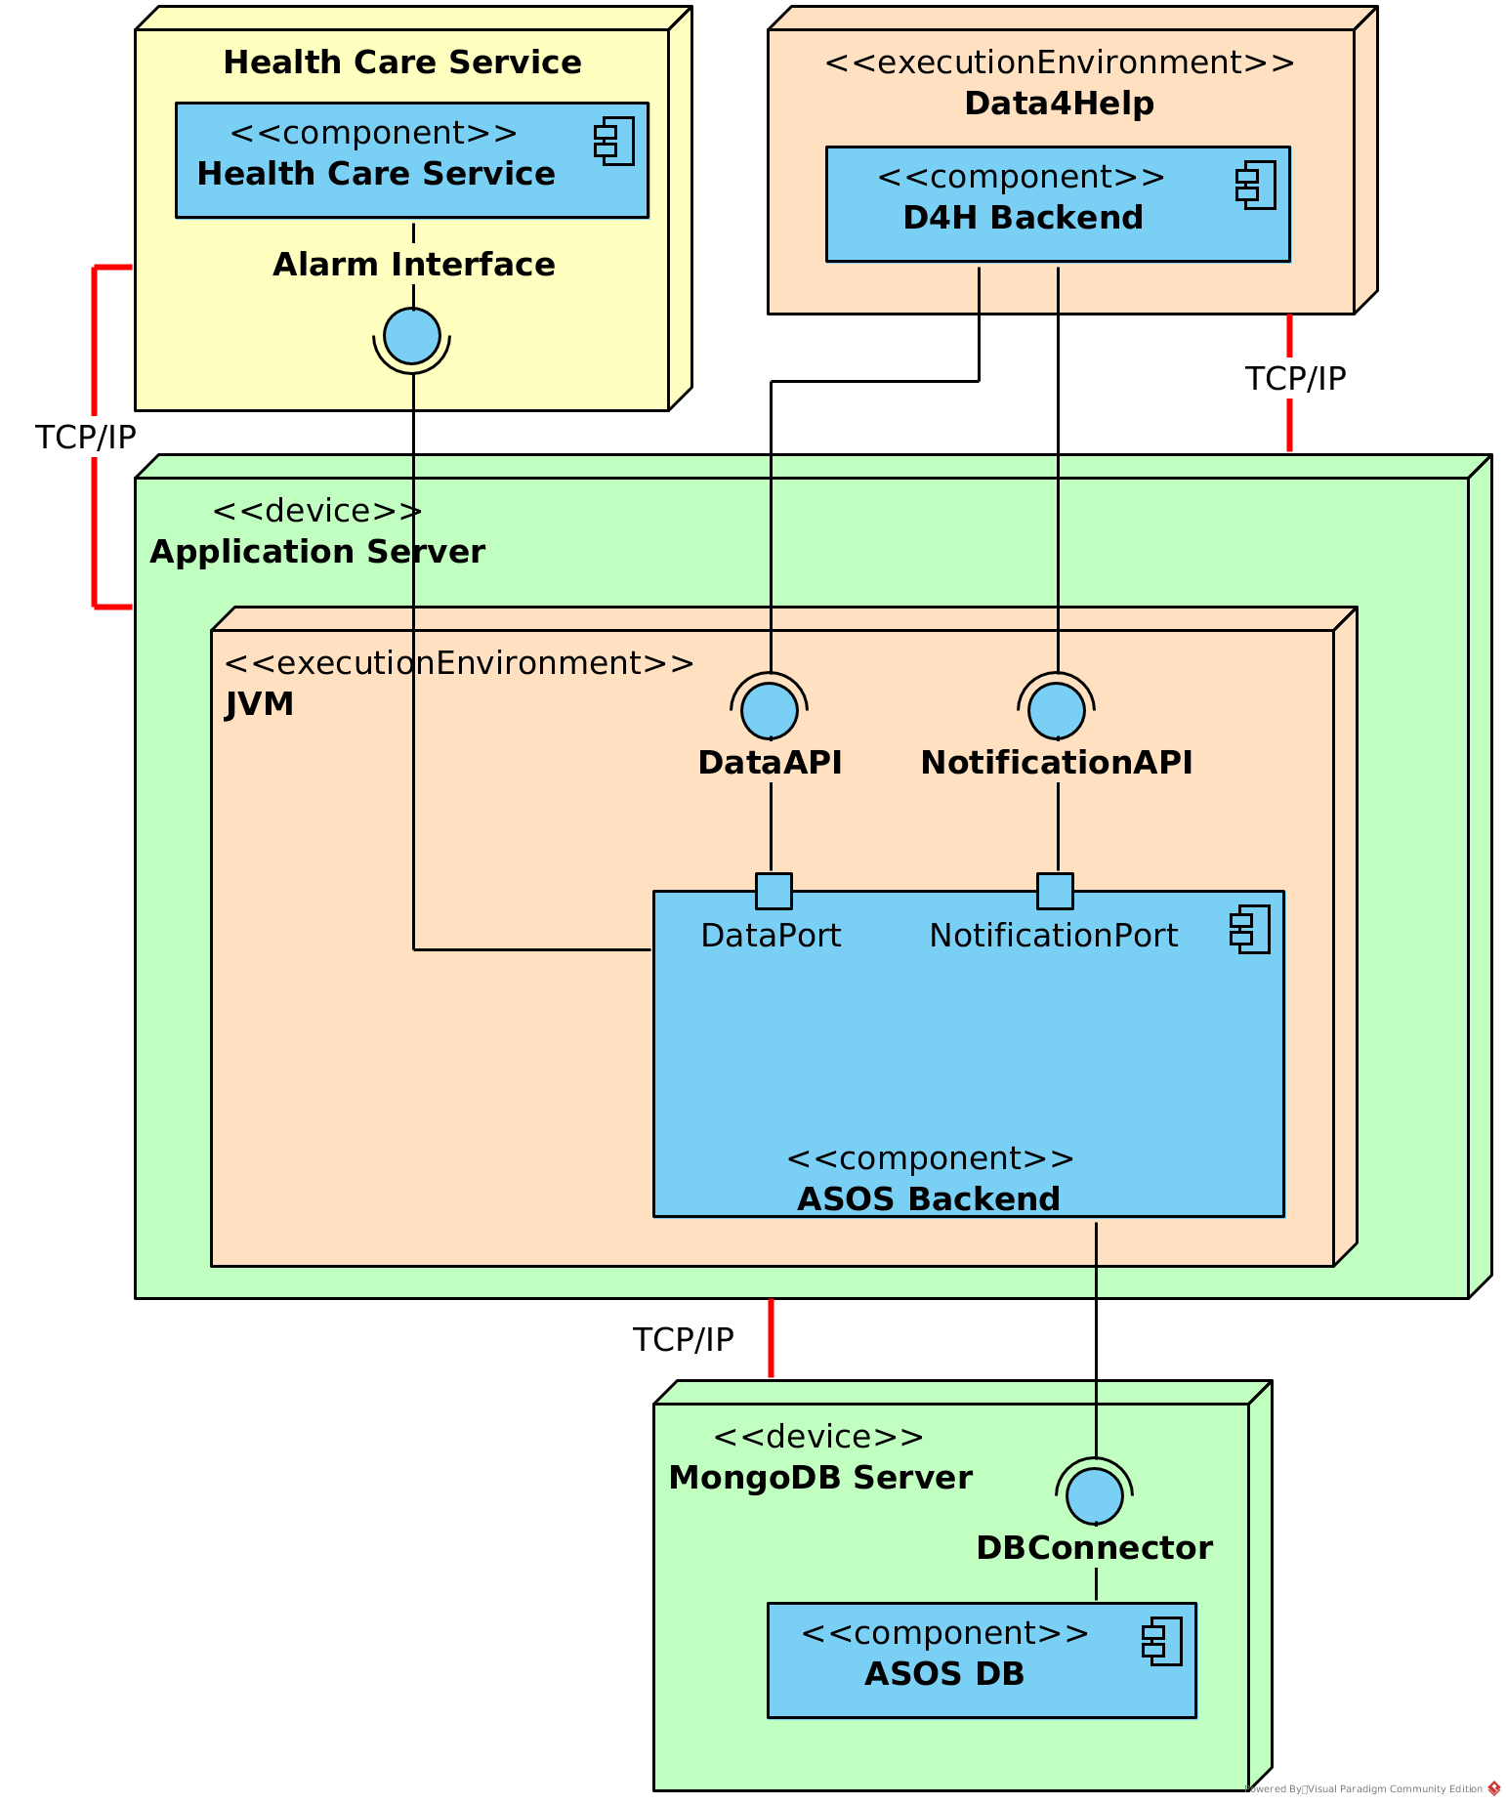
Deployment
<<AutomatedSOS>>
Application Server node contains the backend, which runs in a Java environment.
Application Server communicates with the Data4Help, through the DataAPI and NotificationAPI, and with the Health Care Service by using their Alarm Interface
Application Server connects to the MongoDB Server using the DBConnector.
There is no web site, hence the Individuals do not have access to the AutomatedSOS system, they can only interact by accepting or rejecting the requests.
Use case diagram
<<Track4Run>>

Slide 26
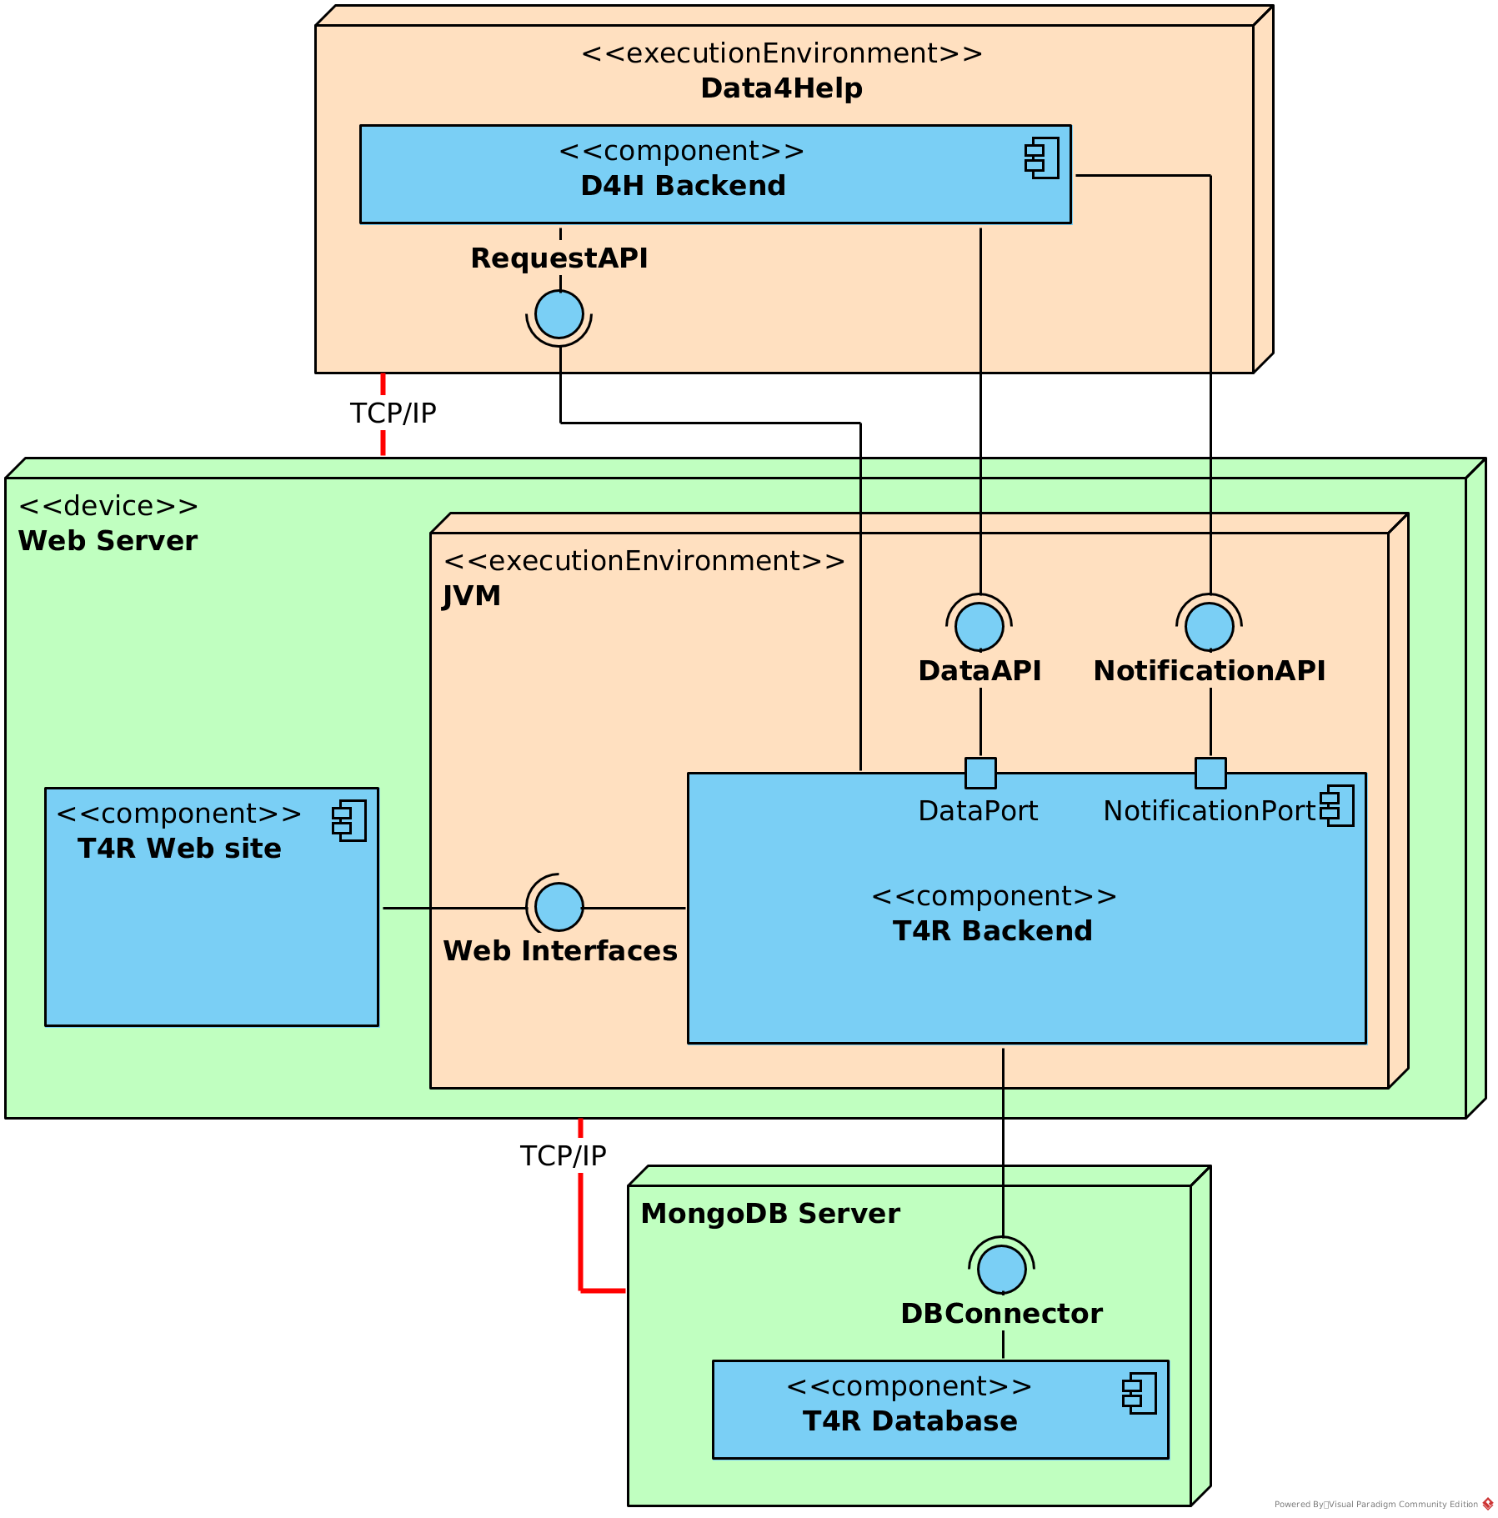
Deployment
<<AutomatedSOS>>
Web Server node contains the web site and the backend (which runs in a Java environment)
Web Server communicates with the Data4Help, through the RequestAPI interface and the DataAPI and NotificationAPI.
Web Server connects to the MongoDB Server using the DBConnector.
The Individuals, Organizers and Spectators can interact with the system through the web site.
Use case diagram
<<Track4Run>>

Slide 27
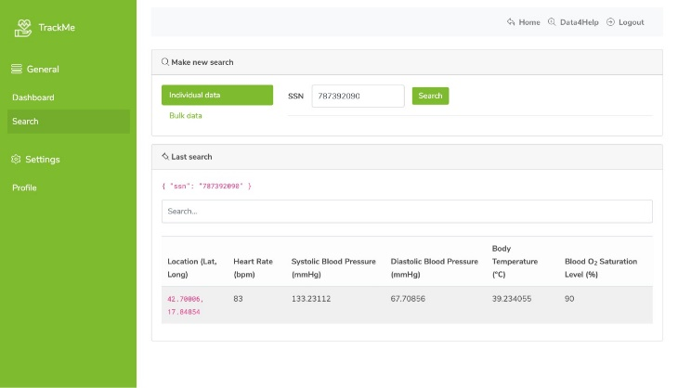
Implementation
Data4Help & AutomatedSOS

Slide 28
Implemented requirements <<Data4Help>>
[R1/R5] Individuals and Third parties registration
[R2/R6] Individuals and Third parties login
Users management
[R7] Notify the individual that a third party company wants to access its data
[R3] Individuals can accept or reject requests of accessing their personal data
Request

Slide 29
[R4] Data4Help can obtain the health status and location of an individual
[R8] Third parties can search for an individual health status and location using his/her SSN
[R9] Third parties can filter data of a group of individuals according to some criteria
[R10] Data of a group of individuals can be anonymized
Search
[R11] Third parties are automatically subscribed to an individual health status and location when the request is approved
[R12] Third parties can subscribe to data of an anonymized group of individuals
Subscription

Slide 30
Implemented requirements <<AutomatedSOS>>
[R13] The system must send a request for monitoring an individual’s data when he/she is older than 60 years old
[R14] The system must monitor, and compare against defined thresholds, the health status of an individual
[R15] The system must be able to contact the health-care service associated to an individual
Data

Slide 31
Development frameworks and technologies
<< Backend>>

Slide 32

Development frameworks and technologies
<< Frontend>>
HTML
CSS
JS

Slide 33
Development frameworks and technologies
<< Additional>>

Slide 34
Integration & Testing
Data4Help & AutomatedSOS

Slide 35
Integration strategy <<bottom-up>>
Integration order:
Data4Help Components
Data4Help Web Site
DBManager, AuthenticationManager
LoginService and SignupService
RequestService, SubscriptionService
SearchManager, UserService, DataService
Schedulers
AutomatedSOS Components
DataService, DBManager
APIManager
Track4Run Components
Track4RunWebService
Track4RunDB
RunCollection
TokenService, OrganizerCollection and ParticipantCollection

Slide 36

System integration testing
Integration order of subsystems:
AuthenticationManager and LoginService
SearchManager, RequestService and SubscriptionService
DataService, DBManager and APIManager
RunCollection and ParticipantCollection
User Interaction Integration:
UserInterface and RequestService
UserInterface and NotificationService
UserInterface and RunCollection
UserInterface and HealthCareService External Resource

Slide 37
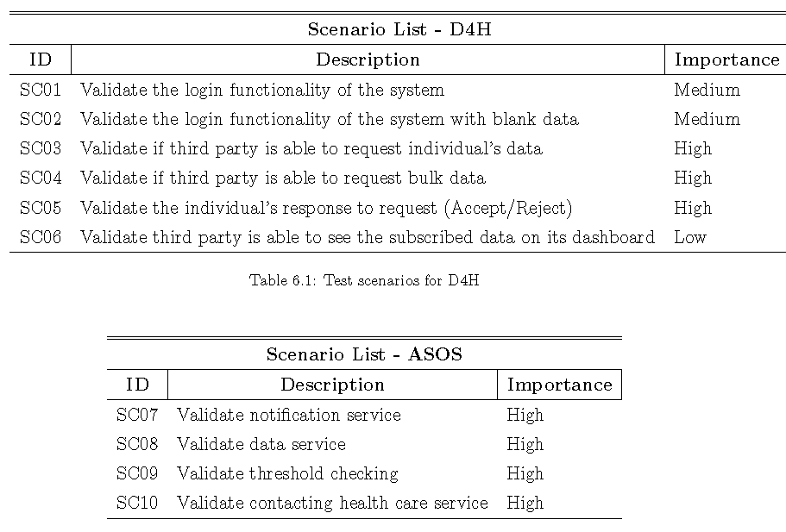
Test plan

Slide 38
Test Plan

Slide 39
Demo Time!

Slide 40
Questions?

Slide 41
Fully Editable Icon Sets: A

Slide 42
Fully Editable Icon Sets: B

Slide 43
Fully Editable Icon Sets: C

